Slide 1
Kevaro Athletics - Roster Systemization & Fiscal Analysis
- A Case Study by Anik Chakraborty

Slide 2
🎯 Objective
To analyze the gender-wise representation and salary distribution across different sports and countries for Kevaro Athletics’ global selection pool. The goal is to identify patterns in participation diversity, pay disparity, and high-salary sports to support equitable athlete management and strategic talent investments.
Project Purpose:
To design a centralized roster intelligence dashboard that provides visibility into athlete distribution, demographic segmentation, and financial investment across sports and countries.
Evaluate the sport-wise and country-wise candidate participation in the selection pool.
Compare total and average salaries between male and female athletes across sports.
Identify top-performing (high-salaried) sports and countries contributing maximum value.
Support Kevaro Athletics in designing data-driven gender equity and sponsorship strategies.
Key KPIs:
Total Active Athletes
Average Age
Age Range
Total Investment
Highest Pay
Country-wise & Sport-wise Salary Distribution
Deliverables:
Interactive Power BI Dashboard (Roster + Fiscal View)
Athlete Segmentation Model (Age Division Logic)
Salary Distribution & Financial Gap Analysis
Country & Gender Participation Analysis
Executive Summary Insights

Slide 3
📘 Project Overview
Context Highlights:
Kevaro Athletics, a global sports organization, manages a diverse roster of 50 athletes representing 11 countries across multiple sporting disciplines.
This project delivers structured visibility into roster composition and financial investment, enabling data-driven decision-making across performance management and resource allocation.
The analysis focuses on:
Athlete distribution across countries and sports
Age segmentation for lifecycle and performance tracking
Gender representation & compensation equity
Investment patterns across regions and disciplines

Slide 4
🗂️ Data Overview & Schema
Data Source:
Source: Fictionalized Sports Company Dataset
Data Type: Structured Tabular Athlete & Financial Data
Time Period: Current Active Roster Snapshot
Data Structure & Metrics:
Key Index Types:
Country
Gender
Age
Blood Type
Sport Location (Indoor/Outdoor)
Salary
Total Rows: 50 Athletes
Countries: 11
Sports Listed: 32
Calculated Metrics:
Age Division Classification (Young, Veteran, Master, Legend, Experienced)
Total Investment
Financial Gap (Max - Min Salary) & Mid Pay (Median Salary)
Country-Level Salary Contribution
Sport-Level Investment Distribution

Slide 5
💻 Tech Stack
Tools:
Excel
Initial Data Cleaning & Structuring
Text Standardization (TRIM / LOWER equivalents)
Salary Format Conversion & Validation
Data Storage & Preprocessing
Power Query
Data Transformation & Shaping
Column Standardization
Age-Based Classification Modeling
Data Preparation for BI Integration
Power BI
Data Modeling & Relationship Building
DAX (Calculated Columns & Measures)
Aggregation by Country, Sport & Gender
Slicers & Dynamic Filtering
Age Segmentation Logic using SWITCH(TRUE())
PowerPoint
Presentation Design, Dashboard Snapshots & Business Insight Documentation

Slide 6
📈 Methodology & Analysis
Preparation, Process & Analytical Approach:
Data Preparation & Cleaning:
Standardized text fields (Country, Sport Location, Gender)
Handled missing values
Converted salary from K format to numeric
Verified age range (27–71)
Data Modeling & Integration:
Built a structured data model
Created Age Division logic
Established relationships across Country, Gender & Sport
Feature Engineering:
Developed Age Segmentation column
Calculated Financial Gap & Gender Ratio
Derived Average Salary by Division & Sport
Visualization Design:
Designed interactive dashboard layout
Used Bar Charts, Donut Chart, Treemap & KPI Cards
Built Fiscal Overview for salary analysis
Validation & Formatting:
Verified 50 athletes & $3.36M total investment
Cross-validated salary totals
Applied consistent executive theme

Slide 7
❓ Problem Statement
In a globally competitive sports environment, data-driven roster and financial transparency are essential for sustainable performance and equitable growth. However, without a structured analytical framework, decision-makers lack the clarity needed to optimize talent allocation, compensation fairness, and investment strategy.
Key Questions:
What is the overall gender representation in Kevaro’s global selection pool?
How are athletes distributed across countries and sports?
Which sports generate the highest total and average salaries?
Is there evidence of a gender or age-based pay gap?
Which countries contribute the highest athlete count and salary volume?
What is the investment concentration across sports and regions?
Are there signs of over-investment in specific demographics?
What is the financial gap across age divisions?

Slide 8
💡 Key Insights
Top Findings:
Total Investment: $3.36M
Balanced Gender Participation: 25 Male & 25 Female athletes selected globally
Gender Salary Split:
Male: $1.73M (51.15%)
Female: $1.63M (48.49%)
Highest Investment Sport: Beach Volleyball (~$0.29M)
Top Contributing Country: France (~$0.61M salary allocation)
High-Salary Sports: Cycling Road, Volleyball, Alpine Skiing & Triathlon
Age Structure: Strong mid-to-late career representation (Avg. Age: 49)
Maximum Individual Salary: $117.40K
Financial Gap: Noticeable variance across age divisions
Supporting Metrics:
32 Sports across 11 Countries
Countries with highest athlete count: France (9), Australia (8), USA (7)
Evidence of pay concentration in endurance & cycling-related sports
Master Division athletes show higher average earning tier
Some sports show gender-dominant salary trends

Slide 9
📍 Conclusion
Summary:
Kevaro Athletics demonstrates strong gender balance in participation, yet salary distribution varies across disciplines.
While some sports reflect female earnings leadership, others show a male-dominant pay concentration, indicating opportunities for targeted parity initiatives and performance-linked compensation review.
The analysis highlights:
Balanced gender investment overall
Regional concentration in European markets
Financial dominance of endurance & cycling sports
Clear age-based salary progression trends
The integrated dashboard combines roster intelligence with financial analytics, enabling leadership to make data-driven allocation and equity-focused decisions.

Slide 10
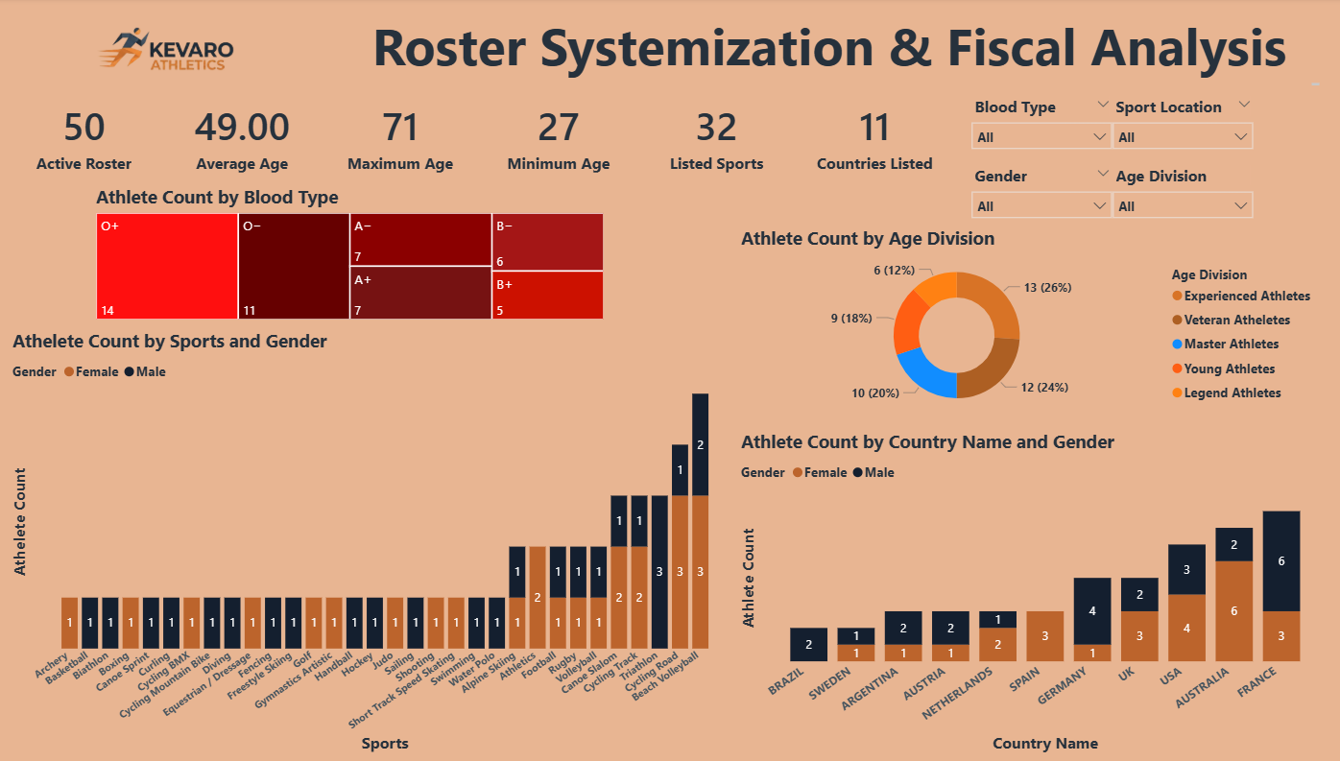
🖥️Dashboard Overview (1) - Roster Insights

Slide 11
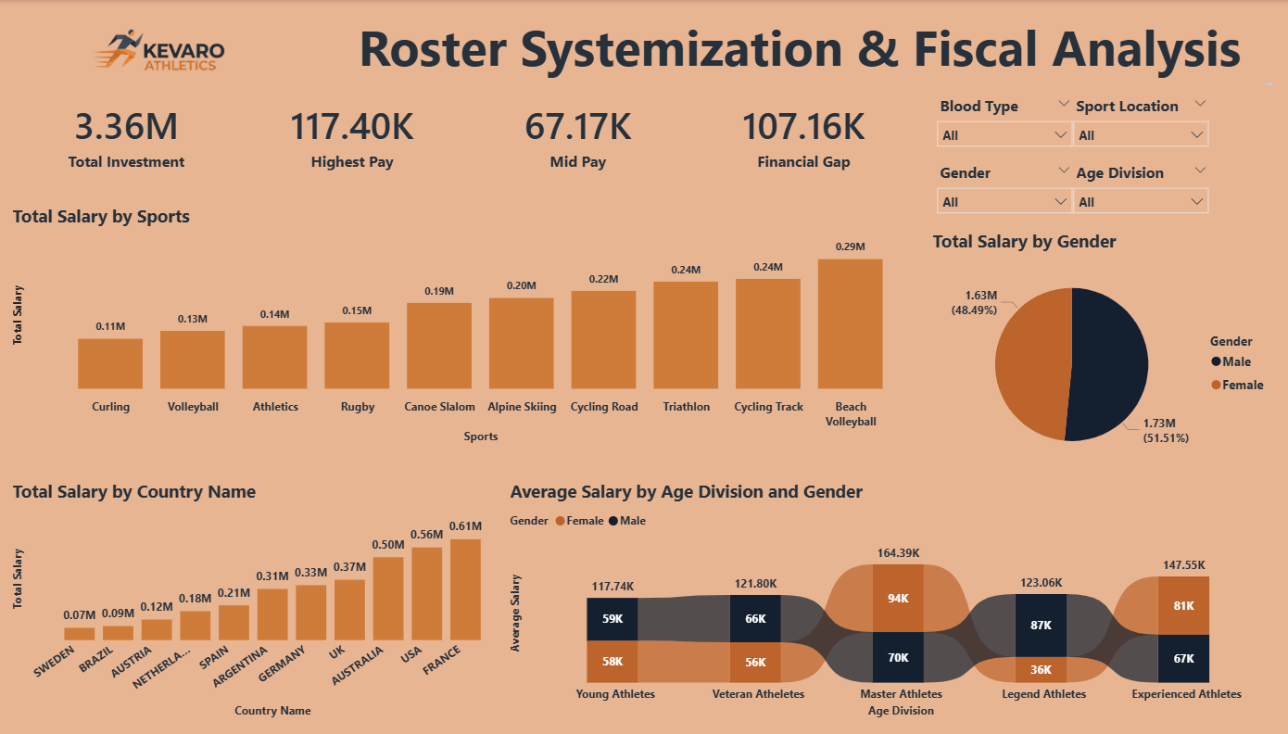
🖥️Dashboard Overview (2) - Fiscal Overview

Slide 12
✅ Business Impact & Use Cases
Supports Gender Equity Reporting & Pay Gap Monitoring aligned with global sports standards
Enables Strategic Salary Budgeting & Sponsorship Alignment by sport and gender
Empowers HR to identify underrepresented sports & talent gaps
Forms the foundation for a future Diversity & Inclusion Dashboard
Strengthens Strategic Budget Allocation & Investment Planning
Assists in Talent Lifecycle & Age-Based Performance Planning
Supports International Expansion Strategy through country-level insights
Identifies High-Investment & High-Return Sports
Enhances Executive Decision-Making with Real-Time Interactive Insights

Slide 13
🙏 Acknowledgement & Contact
Project Analyst: Anik Chakraborty 📧 Email: anikc1710@gmail.com
Special Thanks To:
Coding Ninjas – for project framework and guidance
Connect: 🔗 GitHub | 🔗 LinkedIn

Slide 14
Thank You!

